Slide 1

Hamster Capstone Project
By: Jared Hemauer, Rylee Horney, Keenan Keams, Joseph Lopez

Slide 2

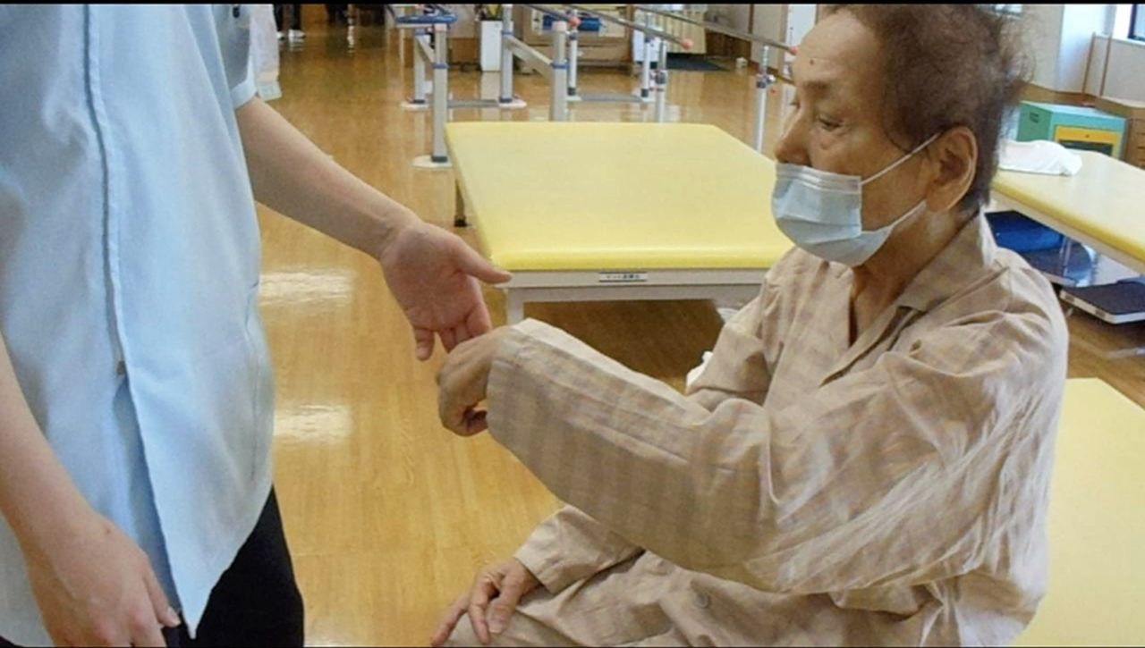
Introduction
Create a product that will aid with the mobility of stroke patients in their arms
The "robot" will be small enough to be transported easily and move across a table the size of a small desk
Final prototype will provide feedback of position and receive inputs to move in any direction that is desired
Our Sponsor: Reza Sharif Razavian
Importance of project:
To help stroke patients gain mobility in their arms in a more efficient and consistent manner
Reduce the amount of "in house" patient care for physical therapists
PHOTO

Slide 3
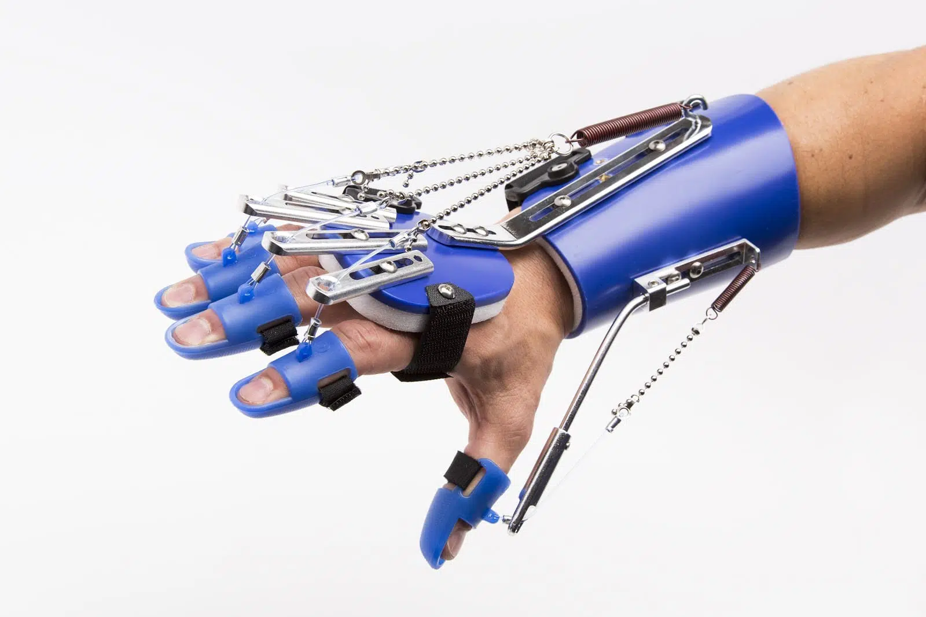
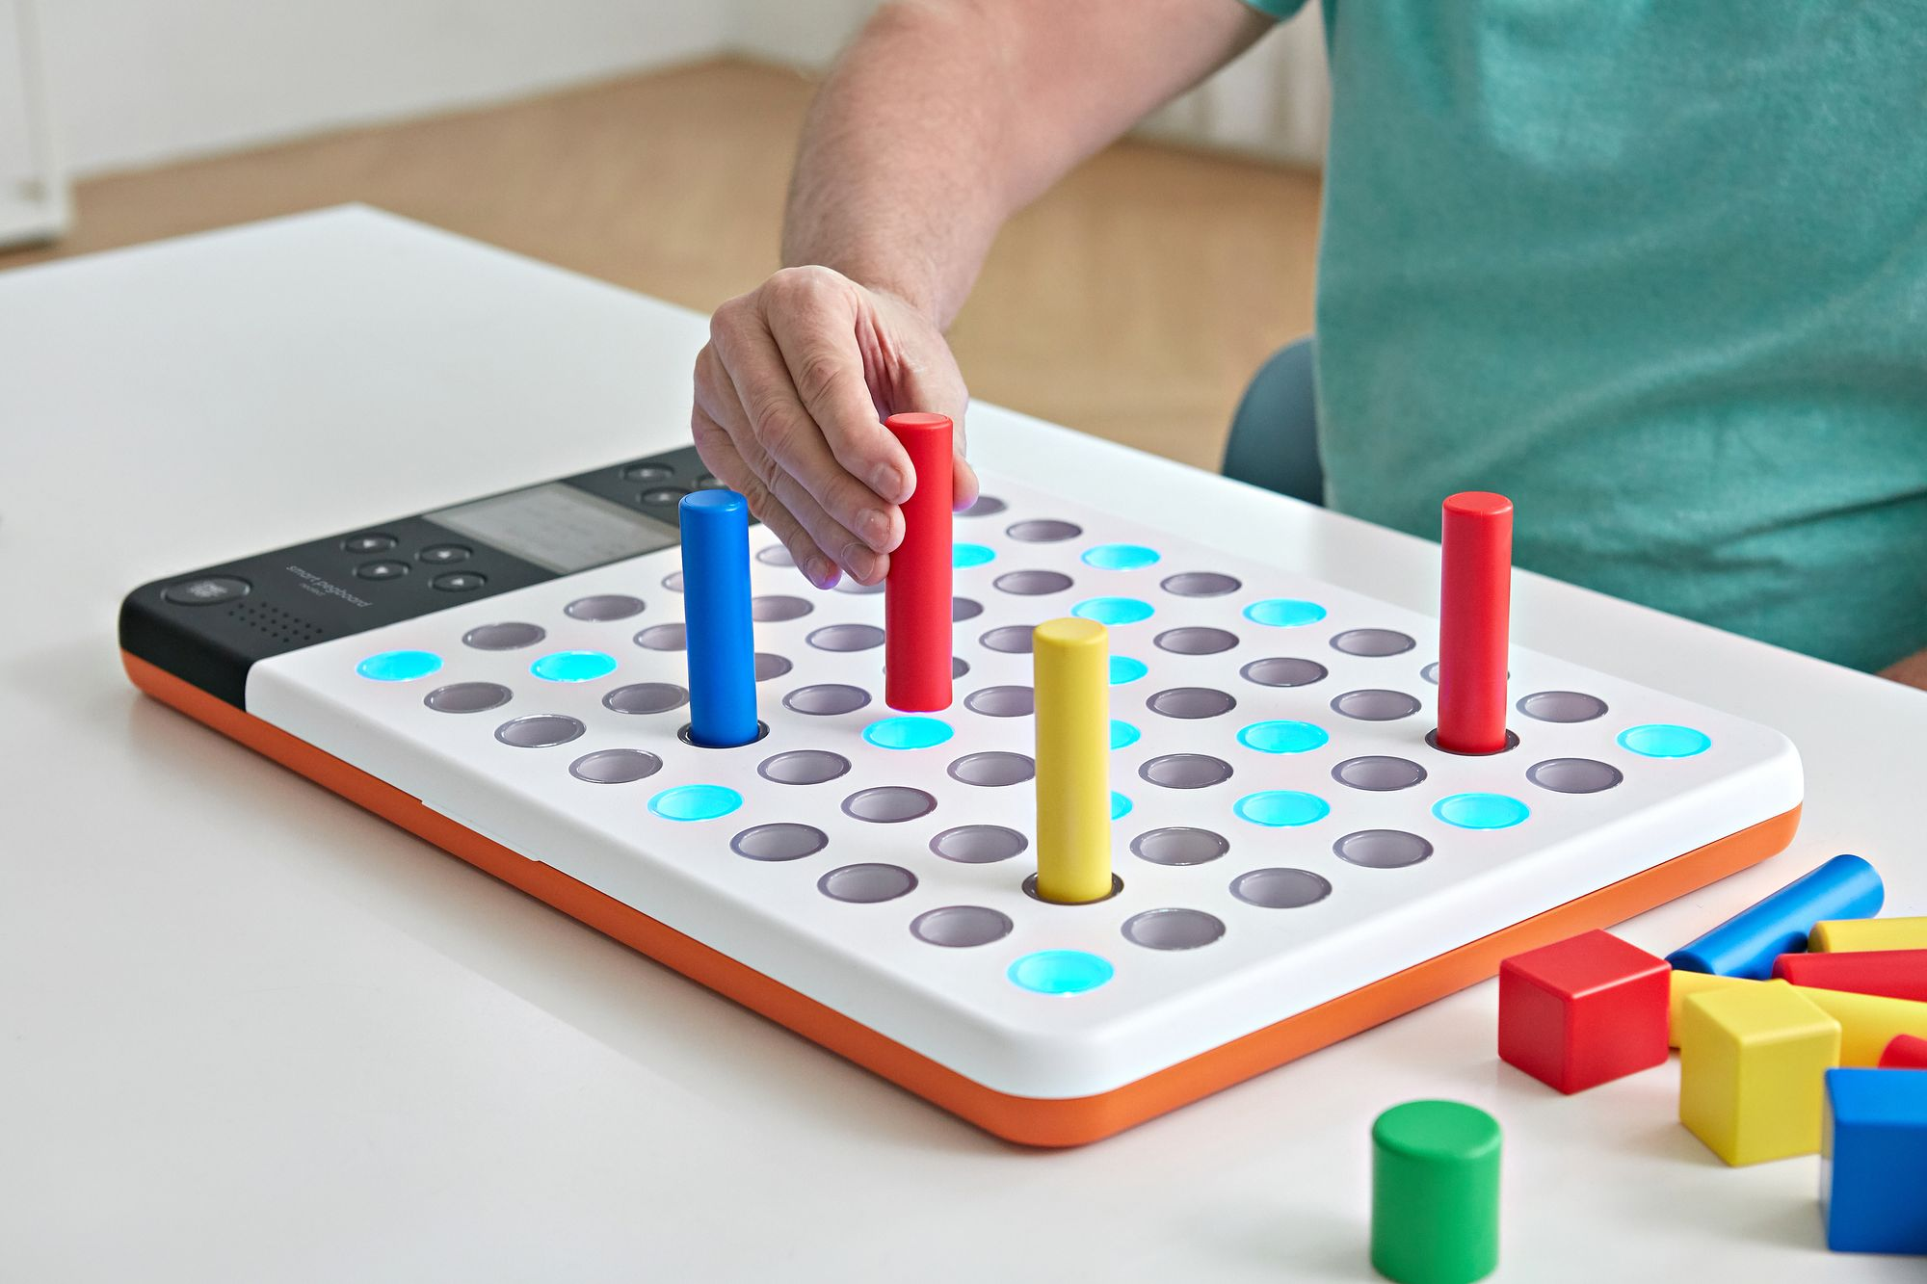
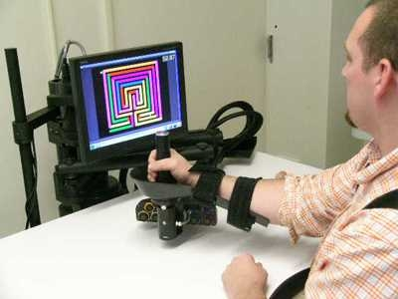
Other Designs
(Figure 1: SaeboFlex)
(Figure 2: Neofect Smart Pegboard)
(Figure 3: MIT Robot)

Slide 4
Design Requirements & QFD
1: low, 5: high | Technical Requirements (How's) → | Motor Output (Kw) | Battery Life (Kw*hr) | Size (m) | CPU Speed (s) | Weight (kg)
Customer importance rating | Customer Requirements - (What's) ↓ |  |  |  |  |  | Weighted Score | Human PT | Neofect Smartboard | Saebo Flex
5 | Must move 10N | 9 |  | 5 |  | 3 | 85 | 9 | 0 | 5
4 | Handheld |  | 3 | 9 |  | 9 | 84 |  | 3 | 8
5 | Moves 1m/s | 9 |  |  |  | 4 | 65 |  | 0 | 0
1 | 5N*m=Torque | 9 |  |  |  |  | 9 | 9 | 0 | 2
2 | Bidirectional Communication |  |  |  | 9 |  | 18 |  | 6 | 0
3 | Cheap | 5 | 5 | 5 | 5 | 6 | 78 | 1 | 2 | 4
4 | Comfortable |  | 5 | 8 |  | 4 | 68 | 4 | 8 | 5
3 | Ease of use |  | 7 | 6 | 4 | 4 | 63 | 6 | 8 | 6
3 | Rechargable w/ 30 minute battery life |  | 9 |  | 2 |  | 33 |  | 7 | 0
 | Technical importance score | 114 | 95 | 126 | 51 | 117 | 503
 | Importance % | 23% | 19% | 25% | 10% | 23% | 100%
 | Priorities rank | 3 | 4 | 1 | 5 | 2
 | Target | 10N & 1m/s | 30 Minutes | 1X1X1 ft | 10MHz | >15lbs
Customer Requirements
Must move 10N
Handheld
Moves at 1m/s
Have 5N*m of torque
Bidirectional communication
Cheap
Comfortable
Ease of use
Rechargeable w/ 30-minute battery life

Slide 5
Literature Review
Stroke Rehabilitation with robots: [1]This source makes a substantial contribution to our study on tiny robots for upper limb rehabilitation in stroke patients, providing critical insights into the present state of assistive technology. In the early phases, it gives useful overviews of existing devices, which help us discover market gaps and refine our project goals and design requirements.
Batteries: [7]This source focuses on the complexities of rechargeable batteries, which are critical to our little robot project. It informs technical needs, addresses power management difficulties, and directs battery technology and efficiency considerations, resulting in a more streamlined and effective robotic system for stroke rehabilitation.
PHOTO
PHOTO
Sensors: [4]This book offers many educational resources for mechatronics and materials. It includes information on industrial robots, the designing phase, and failure analysis of robots. The book also touches base on control systems, sensors and actuators in mechatronics.
Building Arduinos [5]This book gives an overview of how to build and program Arduino systems. The beginning of the book gives the history of Arduinos and the basics of electronics. The following chapters are about programming systems, sensors, motors, and adding lights to the robot. There are many helpful resources about programming and different types of motors to use for powering your system.

Slide 6
Literature Review Cont.
Microcontrollers: An Overview of Microcontroller Unit: from Proper Selection to Specific Application (Journal Article) [6]
This source provides the appropriate steps when determining what type of microcontroller to use in a device. Included in the paper is a table providing manufacturers of these components and a list of commonly used microcontrollers and their features.
Robotics: Arduino Robotics (Book) [7]
This book can be used to give a general overview of building a robot as well as examples of robots that have been made. It will be a very useful tool for the team since the book provides information regarding sensors, batteries, microcontrollers, and other components that go into a robot. It can also answer any questions that may arise throughout the process of designing and manufacturing.
Wheel Control: Self-localization and navigation of holonomic mobile robot using omni-directional wheel odometry (Conference) [9]
This conference discusses the utility of omni-directional wheels and how they can be controlled. It gives an in-depth analysis and presents some the mathematical equations that would be needed to control each wheel on how to controlled a robot that uses 3 omni-directional wheels for mobility.
Wheel Selection: Comparative Analysis of Mobile Robot Wheels Design (Conference) [11]
This discusses the different types of wheels that could be used when designing a robot. The types of wheel that where discusses were conventional, steering, caster, omni-directional, and mecanum wheels. It also layed out different ways to configure these wheel such as two conventional wheels and one caster wheel, and different layout of omni-directional wheels.
PHOTO

Slide 7
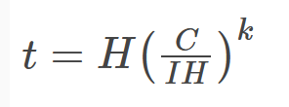
Mathematical Modeling
Battery Life:
Peukert’s Law
t is equal to the amount of time in hours
H is equal to the discharge time in hours
C is equal to the capacity rating (Approx. 1800 mAh)
I is equal to discharge rate in amps
K is equal to a constant
The client expects the device to run for at least 30 minutes while being active on a single charge. So, the approximate voltage for the battery based off calculations made was 1.2 Volts and that would make it run for at least half and hour.

Slide 8
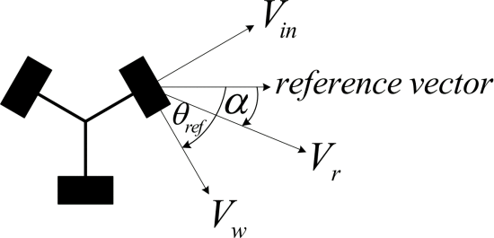
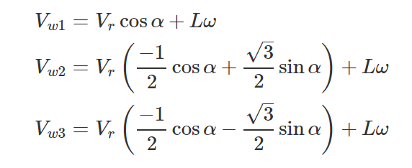
Mathematical Modeling Cont.
Omni-directional Wheel Control
Fig 4: Velocity Equations [8]
Figure 5: Omni-wheel vector diagram [8]

Slide 9
Mathematical Modeling Cont.
Instruction Execution Time:
T_{exec}= 1/f_{cpu}
Texec is the time it takes for the instructions to be executed
fcpu is the microcontroller frequency in Hz [9]
Power Consumption of Microcontroller:
P= f_{cpu} x I
Where I is the current required from the device [10]

Slide 10
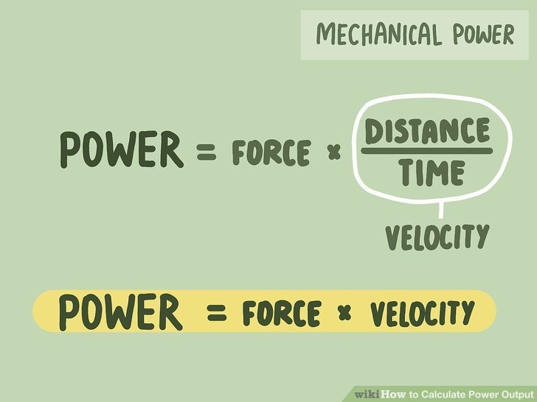
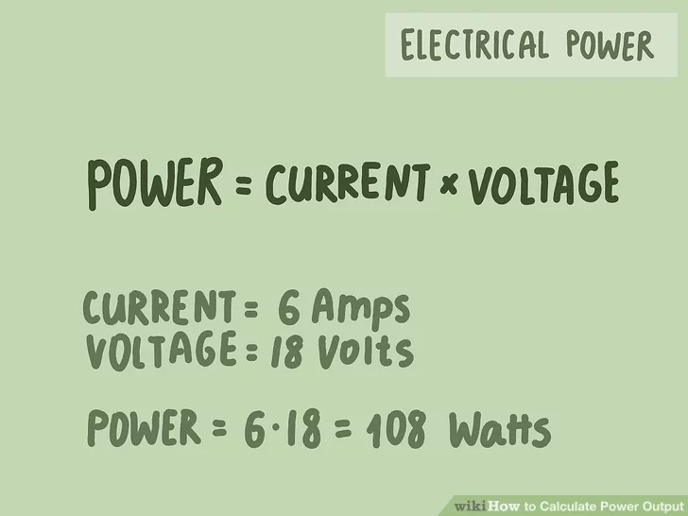
Mathematical Modeling Cont.
Power of motor
Power =(Force x Distance)/ Time
Force = (Power x Time)/ Distance
E – Voltage (V)
I – Amps (A)
P – Power (Watts)
P = IE
Ex : 6A*18V = 108 Watts
Watt = (Joule/Second) = (Newton-Meter/second)

Slide 11
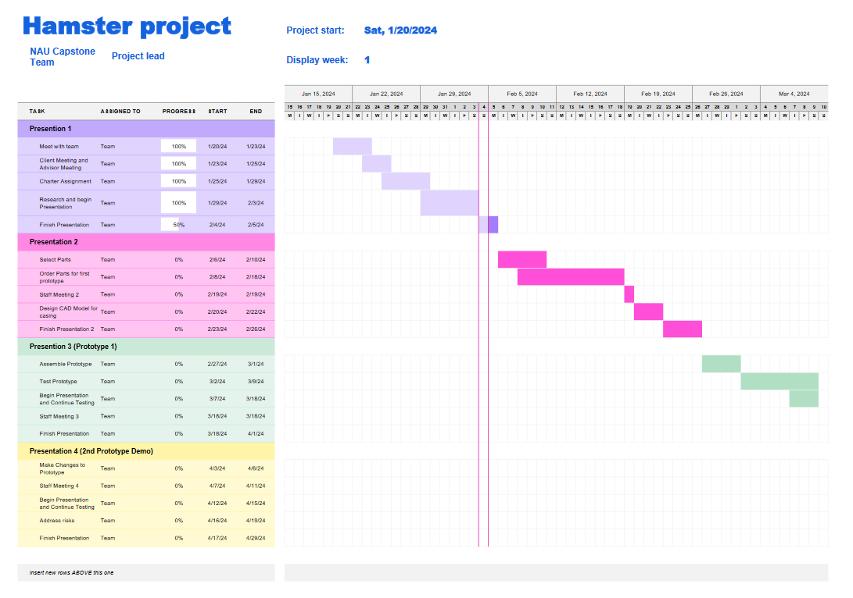
Schedule
PHOTO

Slide 12
Budget & Fundraising
Total Budget: $1000
Anticipated Expenses: $600 - $700
Wheels, motors, batteries, sensors, microcontroller, and 3D printer material
Expenses to Date: $ 0
Resulting Balance: $1000
Fundraising Plan
The plan is to reach out to family members and possibly local businesses in Flagstaff

Slide 13
References
[1]H. Hoffman, Ed., SaeboFlex. 2018. Accessed: Feb. 04, 2024. [Online]. Available: https://www.saebo.com/blog/choose-perfect-stroke-rehab-device-home-use/
[2]Neofect, Neofect Smart Pegboard. 2018. Accessed: Feb. 04, 2024. [Online]. Available: https://www.neofect.com/us/blog/stroke-rehab-products-gadgets-for-stroke-survivors
[3]MIT, MIT Robot for Stroke Patients . 2010. Accessed: Feb. 04, 2024. [Online]. Available: https://news.mit.edu/2010/stroke-therapy-0419
[4]Zdzislaw. Gosiewski and Zbigniew. Kulesza, Mechatronic systems and materials III. Stafa-Zurich, Switzerland: Trans Tech Publications.
[5]J. Hoffman, Mastering Arduino : a project-based approach to electronics, circuits, and programming, 1st edition. Birmingham, UK: Packt Publishing Ltd, 2018.
[6]M. K. Parai, B. Das, and G. Das, “An Overview of Microcontroller Unit: from Proper Selection to Specific Application,” vol. 2, no. 6, 2013.
[7] J.-D. Warren, J. Adams, and H. Molle, Arduino Robotics. New York: Springer, 2011.
[8]J. Inthiam and C. Deelertpaiboon, "Self-localization and navigation of holonomic mobile robot using omni-directional wheel odometry," 2014
[9] S. J. Matthews, T. Newhall, and K. C. Webb, Dive into Systems: A Gentle Introduction to Computer Systems. San Francisco: No Starch Press, 2022.
[10]O. Hiari, “How to estimate your embedded IOT device power consumption,” DEV Community, https://dev.to/apollolabsbin/3-simple-steps-to-estimate-your-embedded-iot-device-power-consumption-1hnl (accessed Feb. 4, 2024).
[11]K. Shabalina, A. Sagitov and E. Magid, "Comparative Analysis of Mobile Robot Wheels Design," 2018 11th International Conference on Developments in eSystems Engineering (DeSE), Cambridge, UK, 2018

Slide 14

Thank You!

